Slide 1

Video Over Wifi
Kavitha

Slide 2
Agenda
Use cases
Problems
Statistics
Improve Signal Strength

Slide 3
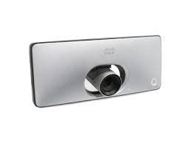
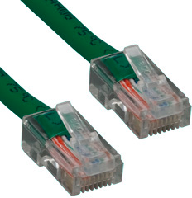

Use Case
Flexibility of not having to deal with wires is a compelling reason to use 802.11 for video streaming

Slide 4

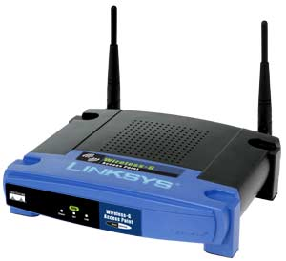
Use case
Encoding Camera 1
Encoding Camera 2
Encoding
Camera 3

Slide 5
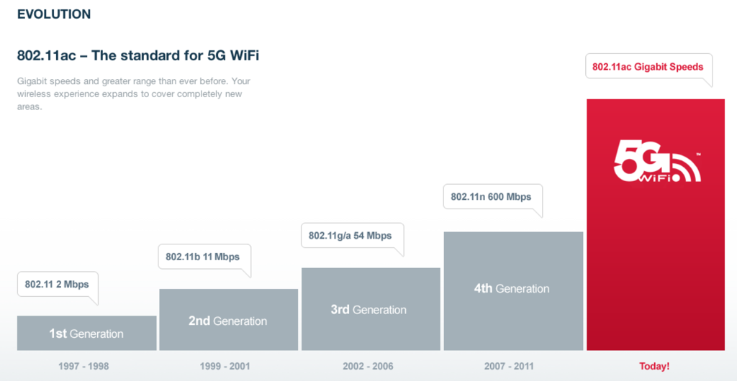
Speeds

Slide 6
Measurements
g speed
Place Link Quality Signal Level Total Speed Near WAP 70/70 -26 dBm 21400 kbps Kavitha's 66/70 -44 dBm 20700 kbps Sofa near Gijo 55/70 -55 dBm 16400 kbps Sofa near Resmi 52/70 -58 dBm 18000 kbps Near Entrance Door 36/70 -74 dBm 4180 kbps Reception 23/70 -87 dBm 30 kbps (disconnected) Near Panna 34/70 -76 dBm 5100 kbps n speed Place Link Quality Signal Level Total Speed Near WAP 70/70 -23 dBm 52453 kbps Kavitha's 66/70 -43 dBm 45900 kbps Sofa near Gijo 57/70 -53 dBm 39000 kbps Sofa near Resmi 49 /70 61 dBm 32000 kbps Near Entrance Door 34/70 -76 dBm 7500 kbps Reception 26/70 -84 dBm 24 kbps (disconnected) Near Panna 43/70 -67 dBm 23017 kbps

Slide 7
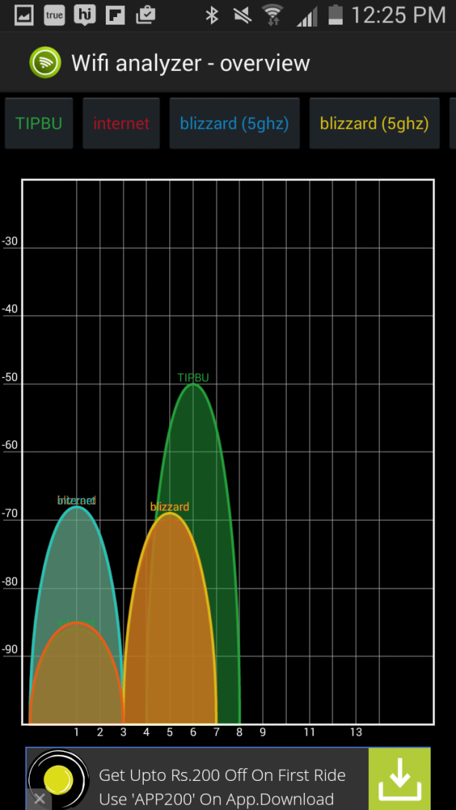
Wifi analyzer

Slide 8
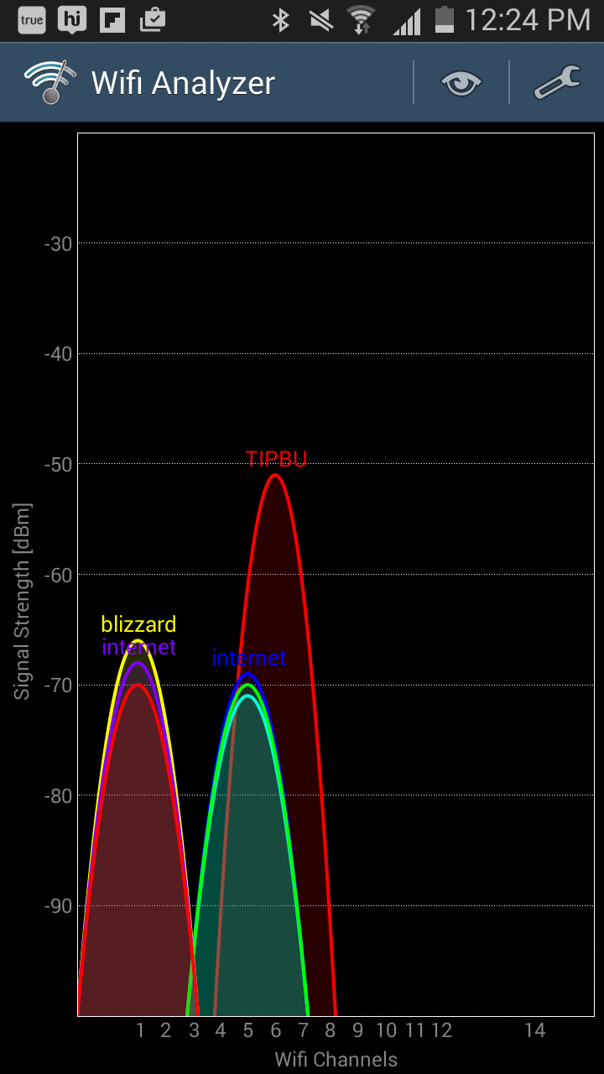

Slide 9
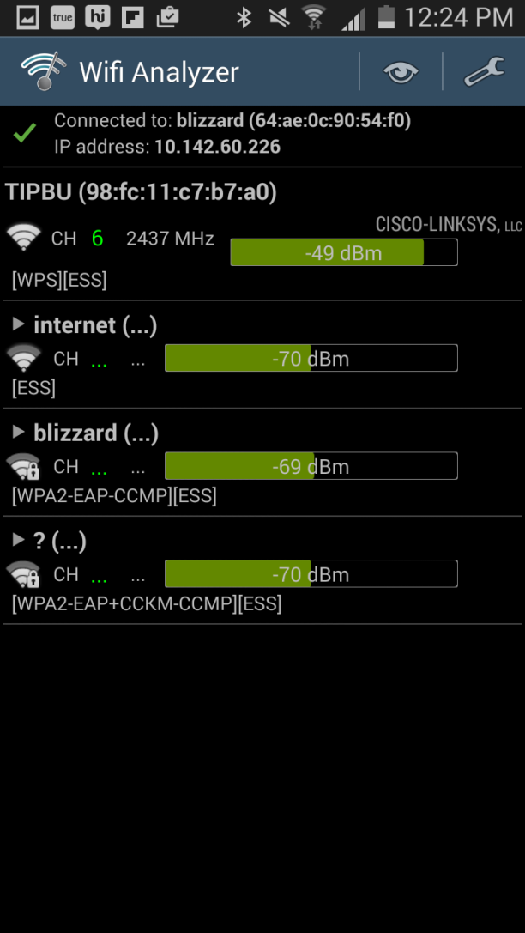

Slide 10
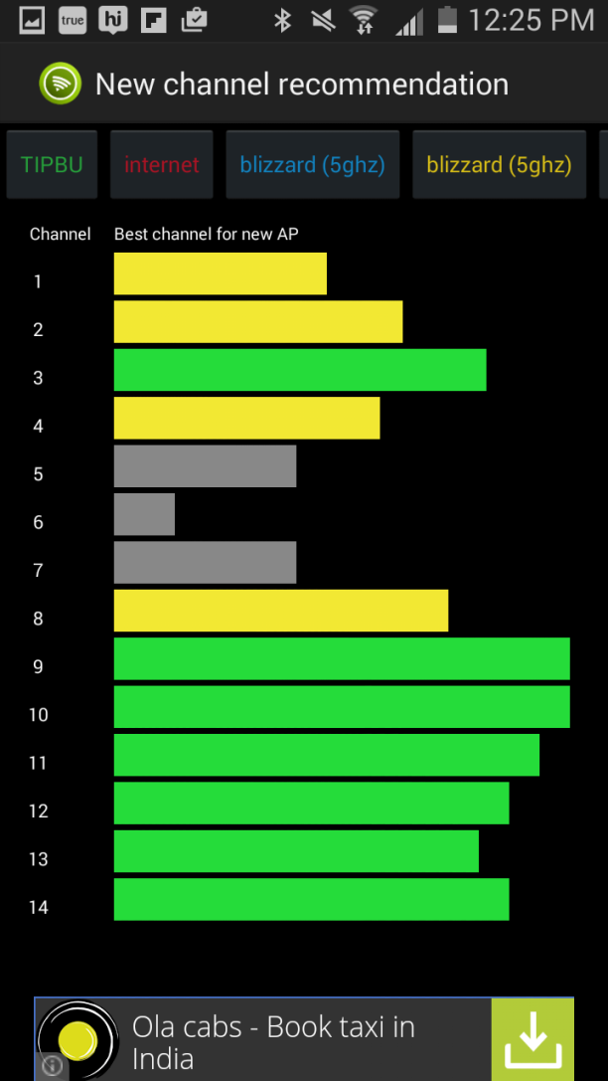
Wifi analyzer

Slide 11
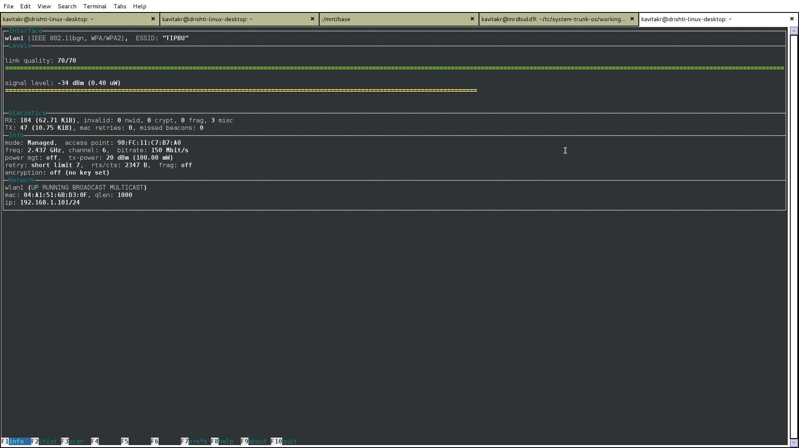
wavemon

Slide 12
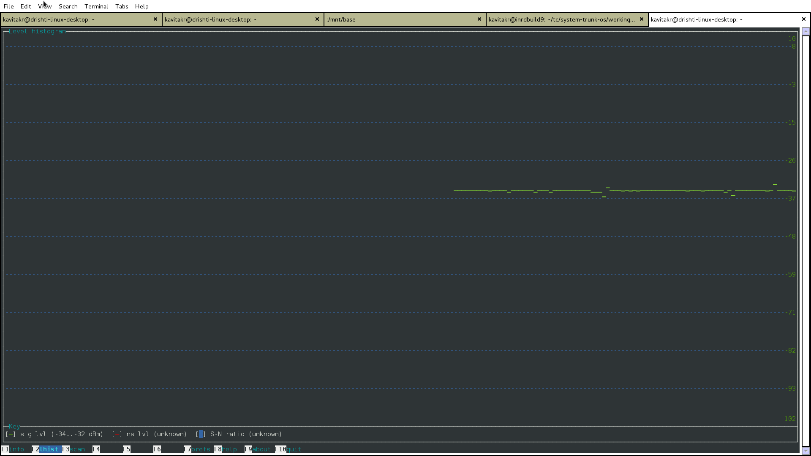
wavemon

Slide 13
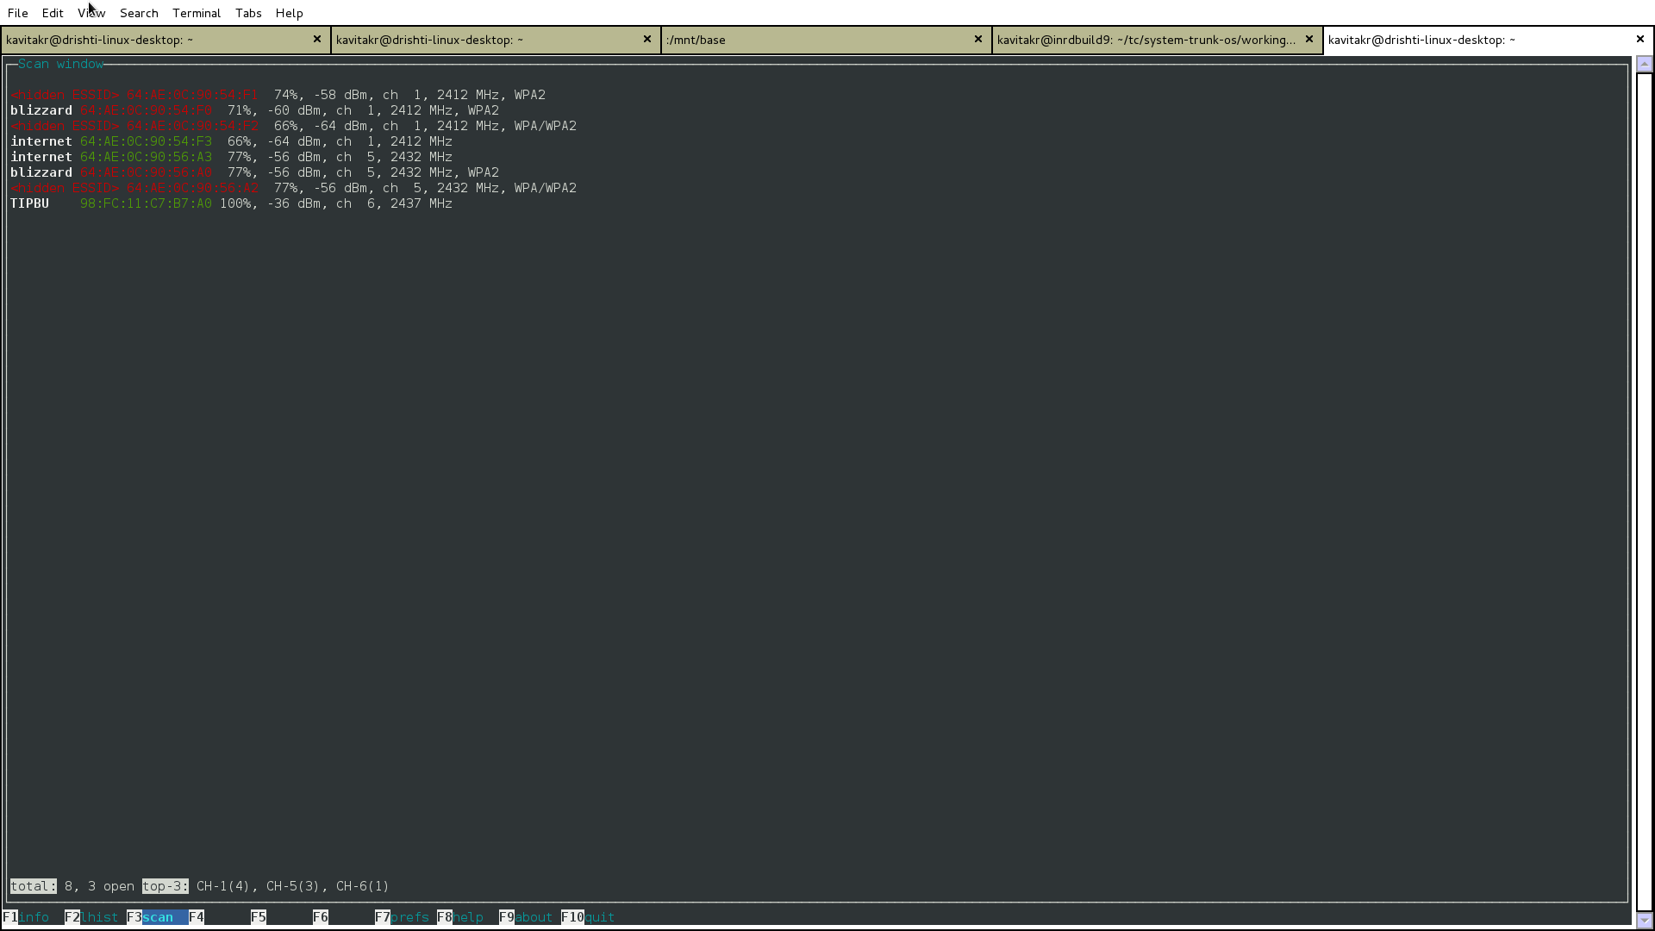
wavemon

Slide 14
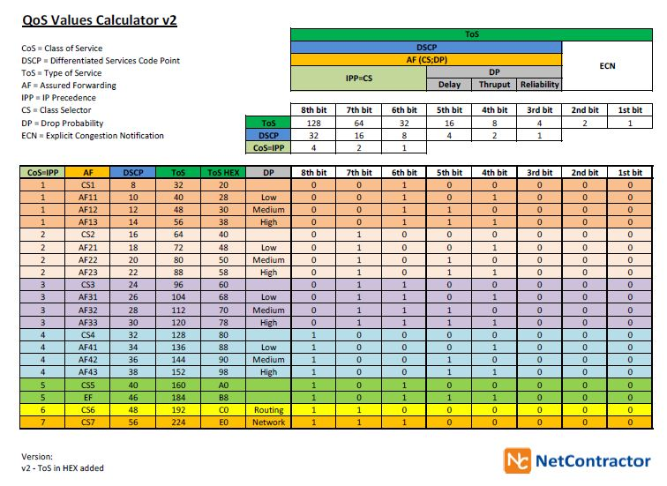

Slide 15
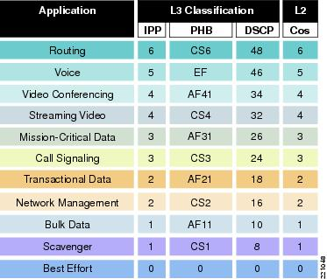

Slide 16
Ping –f –Q hex <IP address>
TOS ms 0 133.570 8 150.624 48 1528.071 160 439.801 224 11.752

Slide 17
Packet Loss

Slide 18
Limitations in current 802.11 mechanisms
Limited prioritization
Lack of inter-layer communication
Limited set of QoS parameters
Limited capability to dynamically tweak QoS parameters
Lack of content-specific methods

Slide 19
Interference, path loss
Limited number of channels in unlicensed bands
Channel characteristics constantly change (dynamic)
Medium access non-deterministic (802.11 is originally designed for data)
STA physically moves in the same BSS
Inter-stream synchronization
Between audio rendered at remote speakers and video
Between one video stream and multiple audio streams

Slide 20
Keep firmware updated[router/adaptor]
Wifi range Extenders and repeaters
Distance impedes performance
Signal bounce around beamforming
Interference
Router position
Antennas
less than 1% packet loss as "good" for streaming audio or video, and 1-2.5% as "acceptable"

Slide 21
WMM
Wi-Fi Multimedia (WMM), previously known as Wireless Multimedia Extensions (WME), is a subset of the 802.11e wireless LAN (WLAN) specification that enhances quality of service (QoS) on a network by prioritizing data packets according to four categories. Network administrators can change priority levels as they see fit.
Ranging from highest priority to lowest, these categories are:
Voice: Giving voice packets the highest priority enables concurrent Voice over IP (VoIP) calls with minimal latency and the highest quality possible.
Video: By placing video packets in the second tier, WMM prioritizes it over all other data traffic and enables support for three to four standard definition TV (SDTV) streams or one high definition TV (HDTV) stream on a WLAN.
Best effort: Best effort data packets consist of those originating from legacy devices or from applications or devices that lack QoS standards.
Background: Background priority encompasses file downloads, print jobs and other traffic that does not suffer from increased latency.

